Slide 1
Lightning Talk 6: Contextualization/Design Check-In
Sddec-16
Cameron Jones,Blake Hardy, Holden Brown, Tejal Devshetwar, Cayden Kelley, Chase O’Connell

Slide 2
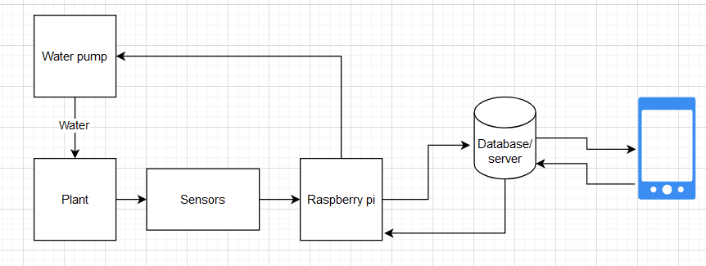
Project Overview
Create a device that automatically collects soil data (NPK,moisture,temperature).
Sends the data to a database on a server.
Create a phone app which presents the collected data of a users soil.
Server has logic that sends commands to automatically water/fertilize plants when certain conditions are met.

Slide 3
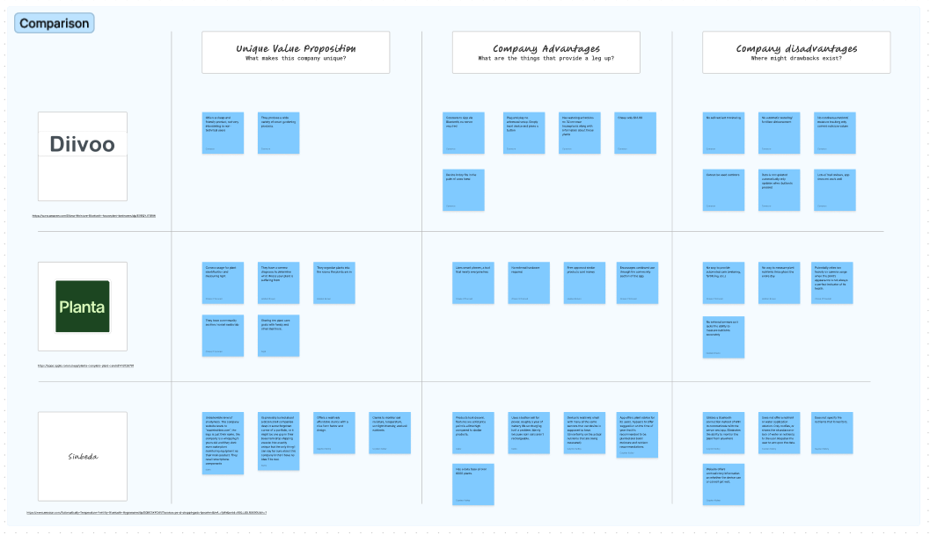
Artifacts

Slide 4
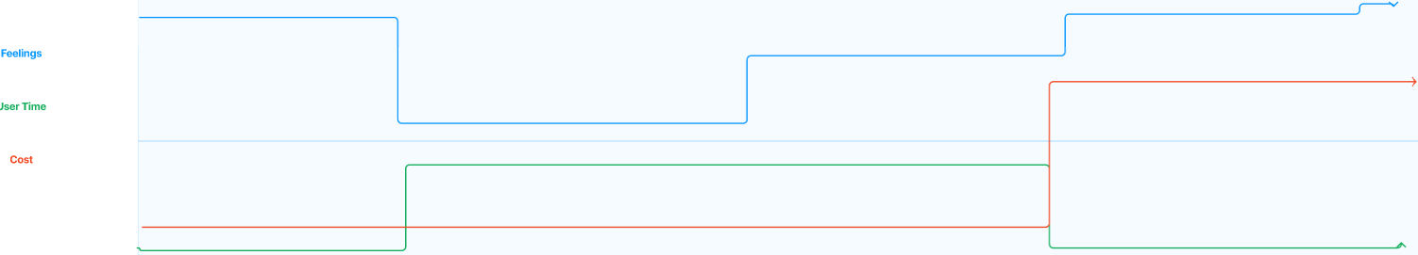
Journey Map

Slide 5
Journey map analysis
May be imposing for a first time user not used to tech
Less imposing than developing a large amount of plant knowledge
Saves time in exchange for a small initial investment

Slide 6
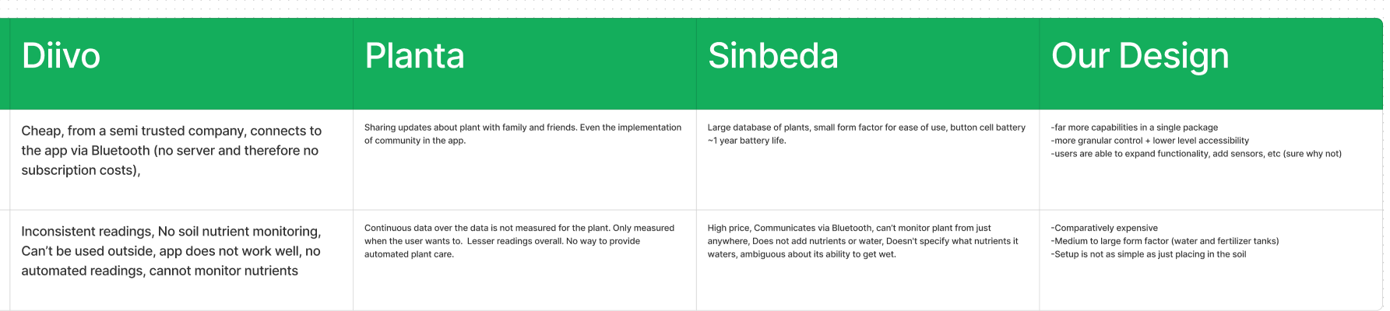
Pro/Con table

Slide 7
Pro/Con table analysis
Most products cheaper than we can produce
Most other products not reliable/frustrating to use
Other products offer limited functionality/little automation
Our product is set apart by moment to moment updates and automated value updating

Slide 8
Human
Addresses user needs to a great extent including detailed information from the sensors displayed on the app, NPK sensors, and information panel about the plant. Thinking from the perspective of a hobbyist( user) we surely are detail oriented in satisfying user needs.

Slide 9
Economic considerations
Similar products are far cheaper, but offer minimal features and questionable accuracy. Our design provides more features and far greater flexibility without significantly increasing cost.
Costs could potentially be reduced further by using an even lower power microcontroller but overall we believe we have found the best middle ground in terms of cost, ease of use, and effectiveness.

Slide 10
Technical
Internal Complexity:
Hardware: Component selection, circuit analysis, datasheet usage
Software: High-level app development, frontend and backend connection, low-level data handling through embedded firmware.
Backend: Server communication between app and microcontroller, data formatting, tool selection.
External Complexity:
Ideally a hands-off approach from the user
Developing a setup procedure to simplify the user experience
Automated process

